Slide 1

Using Open Pulse to Implement Fine $X_{π/2}$ Gate Calibrations
Gontse Masutha
Wendy Ombima
Doreen Mango
Yousha Shoaib
Goodgift Moyo
Headed by Jin-Sung Kim
#28

Slide 2
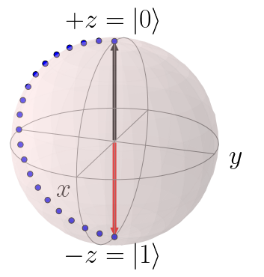
Problem Statement
Pulse level control was previously only available to researchers in the physical lab. With the release of OpenPulse, pulse level optimization of standard gates is now available to users over the cloud. Using OpenPulse, we should be able to implement a fine calibration routine for the Xpi/2 gate, a standard gate in the qiskit gateset, enabling optimization and customization of single qubit gates for the user
Here
Improved
Accuracy
There

Slide 3
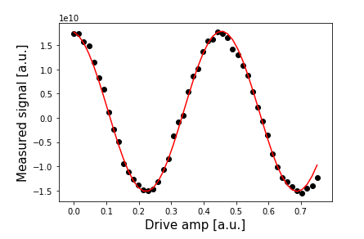
Open Pulse Rough Calibration
Key Ideas;
X90 gates
Open pulse for Pulse level Programming.
Calibration of X90 gates using open pulse.
Calibration of the microwave pulse
Notes:
How;
Given pulse length, choose drive amp
Plot ping pong and run on backend
Plot cos curve and fit ping pong plot onto cos curve
Optimize ping pong fit onto cos curve by calculating angle theta of each pulse applied; compare to pie/2 t o find the variation
Update drive amp by ration of pie/2 to theta to get the fine calibration

Slide 4
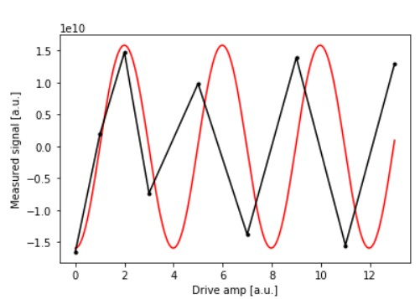
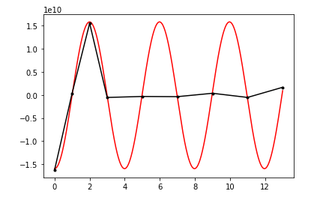


Point of Singularity
Key Ideas;
Optimizing the rough calibration circuit to a fine calibrated circuit
Key Ideas;
Fit the FCC to a cos curve to determine the variation caused by under/over rotation
Implemented Rough Calibration
Uncalibrated $X_{π/2}$
Calibrated $X_{π/2}$
Notes:
How;
Given pulse length, choose drive amp
Plot ping pong and run on backend
Plot cos curve and fit ping pong plot onto cos curve
Optimize ping pong fit onto cos curve by calculating angle theta of each pulse applied; compare to pie/2 t o find the variation
Update drive amp by ration of pie/2 to theta to get the fine calibration

Slide 5
Immediate Next Steps
Automating calibration of the ping pong plot
Integrating our calibrated circuit with randomized bench marking to determine the fidelity of the gate.
Compare Randomized bench marking vs Cross Entropy bench marking with higher valued qubits.

